Slide 1
Risk and Return
Dr. Sarveshwar Kumar Inani
sarveshwarinani@wilp.bits-pilani.ac.in

Slide 2
Agenda:
What is return?
What is risk?
How to compute risk and returns in case of single asset?
How to compute risk and returns in case of multiple assets (Portfolio)?
Simple returns vs CAGR vs holding period return?
Variance, covariance, and correlation?

Slide 3
Risk and Return
Return is the expected cash inflows from the investment (Dividend, interest, capital appreciation)
Risk is associated with the uncertain cashflow/returns (different economic scenarios)
Risk and return need to be assessed and incorporated in the financial decision making

Slide 4
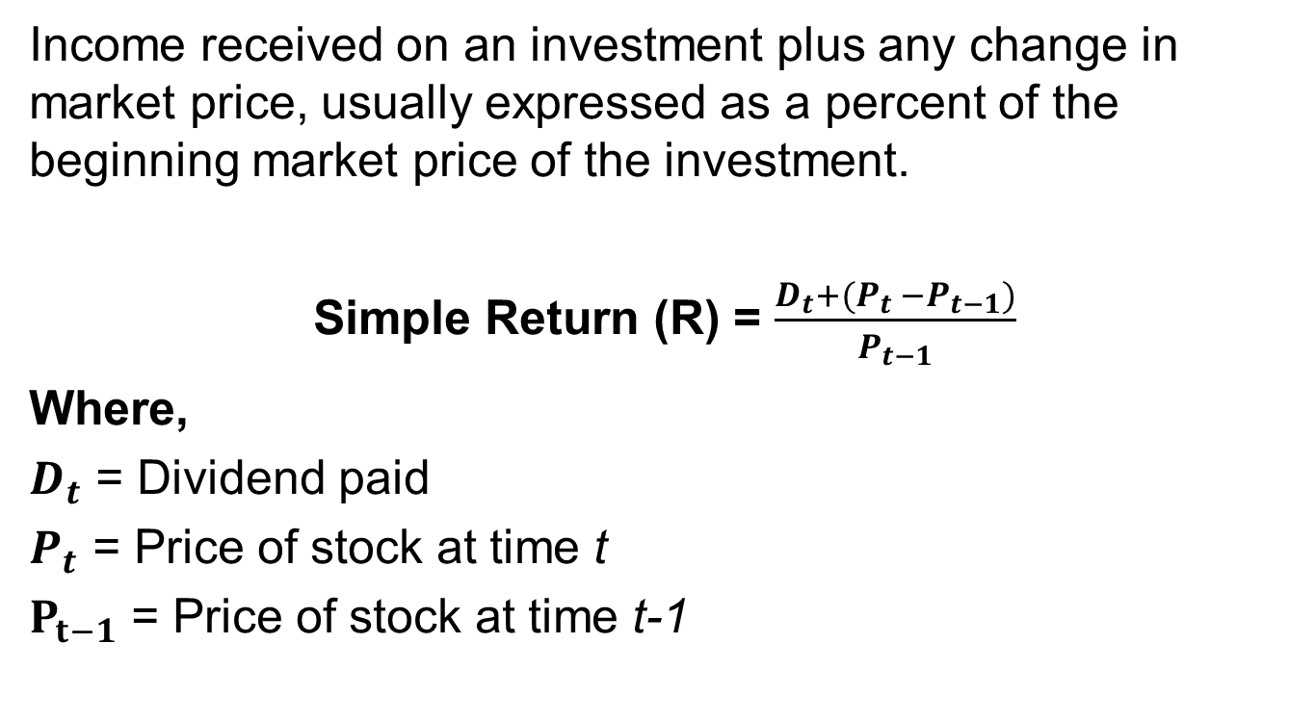
Calculating Total Returns (historical)
Income received on an investment plus any change in market price, usually expressed as a percent of the beginning market price of the investment.
Simple Return (R) = $\frac{D_{t}+(P_{t} −P_{t−1})}{P_{t−1}}$
Where,
$D_{t}$ = Dividend paid
$P_{t}$ = Price of stock at time t
$P_{t−1}$ = Price of stock at time t-1

Slide 5
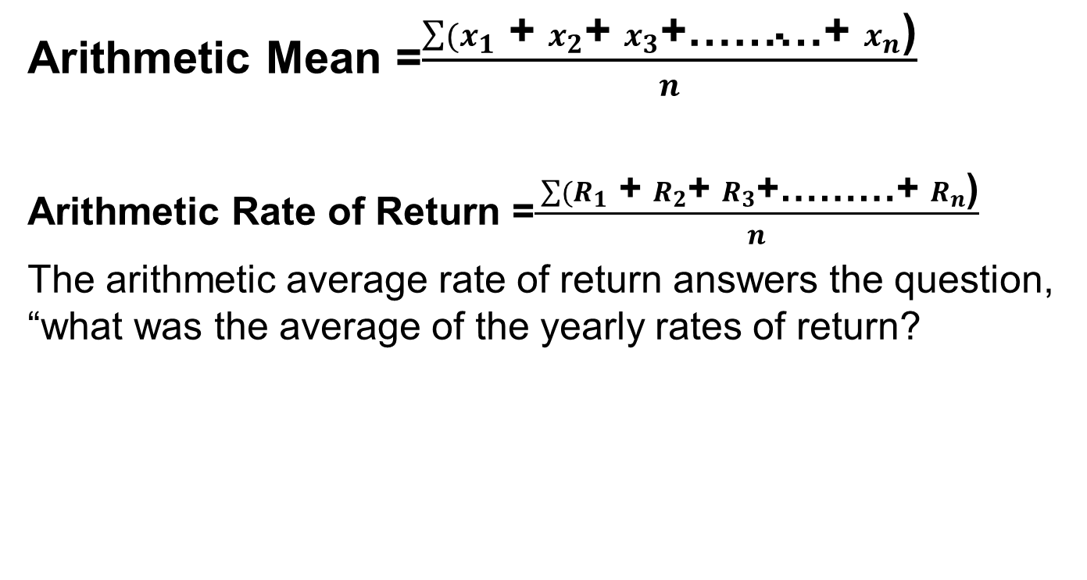
Geometric Vs. Arithmetic Average Rate of Return
Arithmetic Mean =$\frac{\sum{(x_{1}}\text{ + }x_{2}\text{+ }x_{3}\text{+………+ }x_{n}\text{)}}{n}$
Arithmetic Rate of Return =$\frac{ \sum{(R_{1}}\text{ + }R_{2}\text{+ }R_{3}\text{+………+ }R_{n}\text{)}}{n}$
The arithmetic average rate of return answers the question, “what was the average of the yearly rates of return?

Slide 6
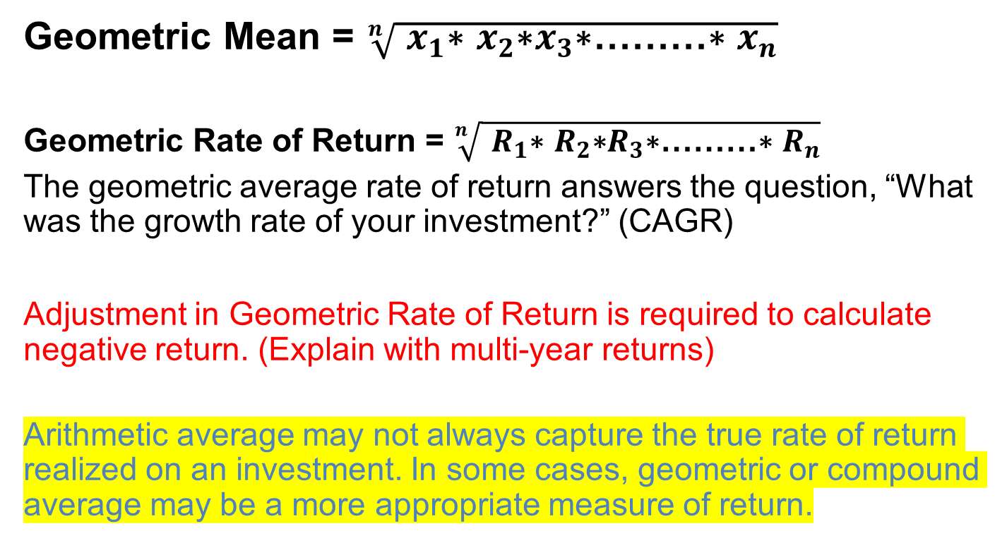
Geometric Vs. Arithmetic Average Rate of Return (historical)
Geometric Mean = $\sqrt[n]{ x_{1}\text{∗} x_{2}\text{∗}x_{3}\text{∗}\text{………}\text{∗} x_{n}}$
Geometric Rate of Return = $\sqrt[n]{ R_{1}\text{∗} R_{2}\text{∗}R_{3}\text{∗}\text{………}\text{∗} R_{n}}$
The geometric average rate of return answers the question, “What was the growth rate of your investment?” (CAGR)
Adjustment in Geometric Rate of Return is required to calculate negative return. (Explain with multi-year returns)
Arithmetic average may not always capture the true rate of return realized on an investment. In some cases, geometric or compound average may be a more appropriate measure of return.

Slide 7
Holding period return (historical)
The returns for entire holding period
For example, INR 100 investment grown to 150 in 5 years.
Then, holding period return is 50% for this holding period of 5-years.
Refer to Excel

Slide 8
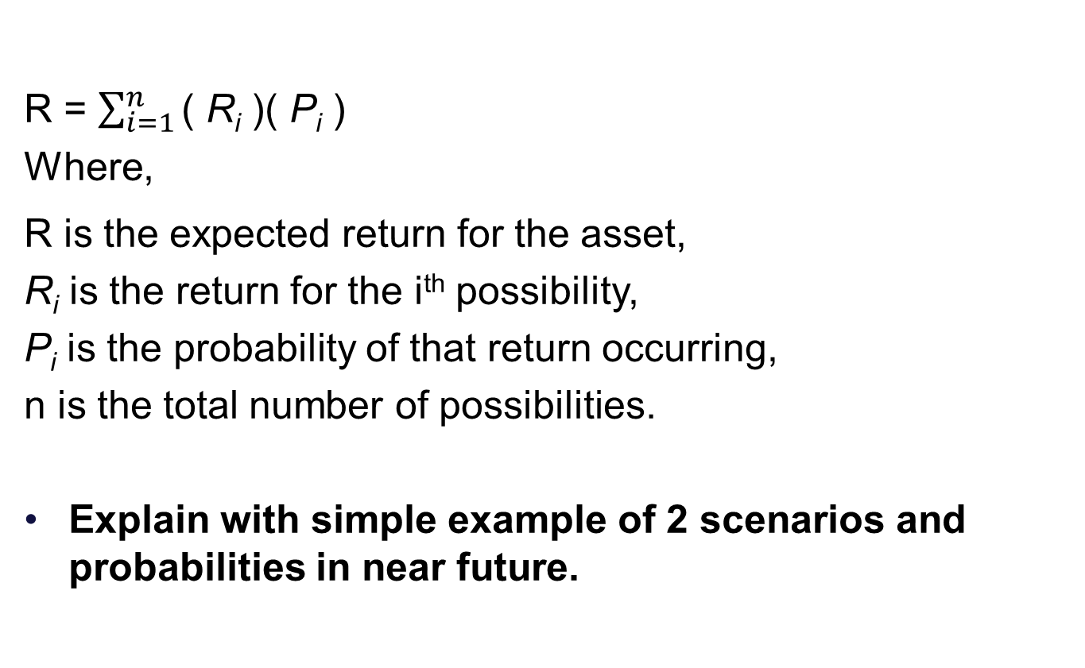
Expected Return (for future) (With probability/scenarios)
R = $\sum_{i=1}^{n}{\text{( }\text{R}\text{i}\text{ )( }\text{P}\text{i}\text{ ) }}$
Where,
R is the expected return for the asset,
R_{i} is the return for the i^{th} possibility,
P_{i} is the probability of that return occurring,
n is the total number of possibilities.
Explain with simple example of 2 scenarios and probabilities in near future.

Slide 9
Risk
The variability of returns from those that are expected.
Once the risk characterising future cashflows is measured, an appropriate risk-adjusted discount rate should be applied to convert future cash flows into their present values.
To estimate the risk-adjusted discount rate – one has to measure and price financial risk.
Measured by Standard Deviation, σ, which is a statistical measure of the variability of a distribution around its mean.

Slide 10
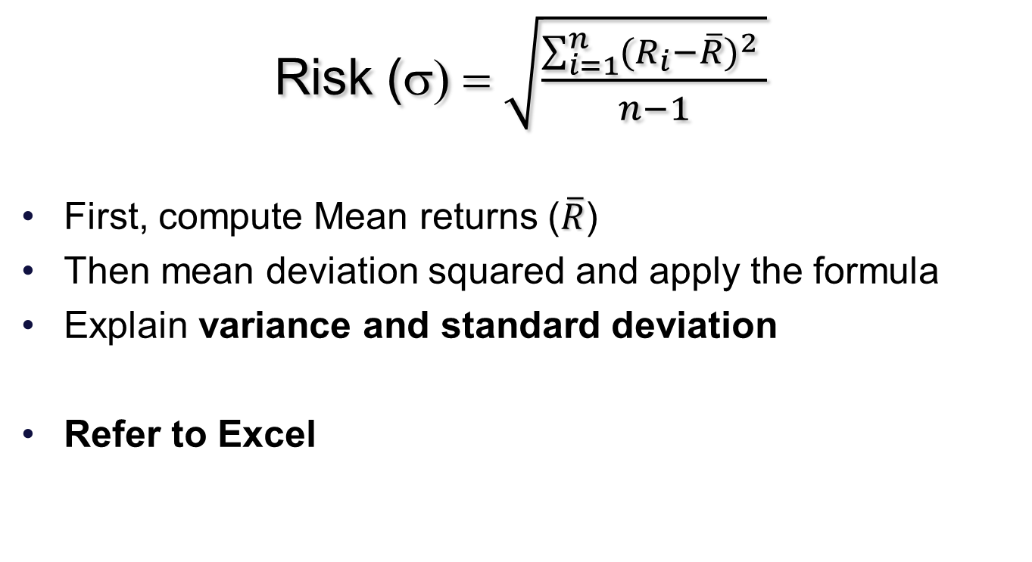
Calculation of Risk (historical)
Risk (σ) = $\sqrt{\frac{\sum_{i=1}^{n}{{(R_{i}−\overline{R})}^{2} }}{n−1}}$
First, compute Mean returns ($\overline{R}$)
Then mean deviation squared and apply the formula
Explain variance and standard deviation
Refer to Excel

Slide 11
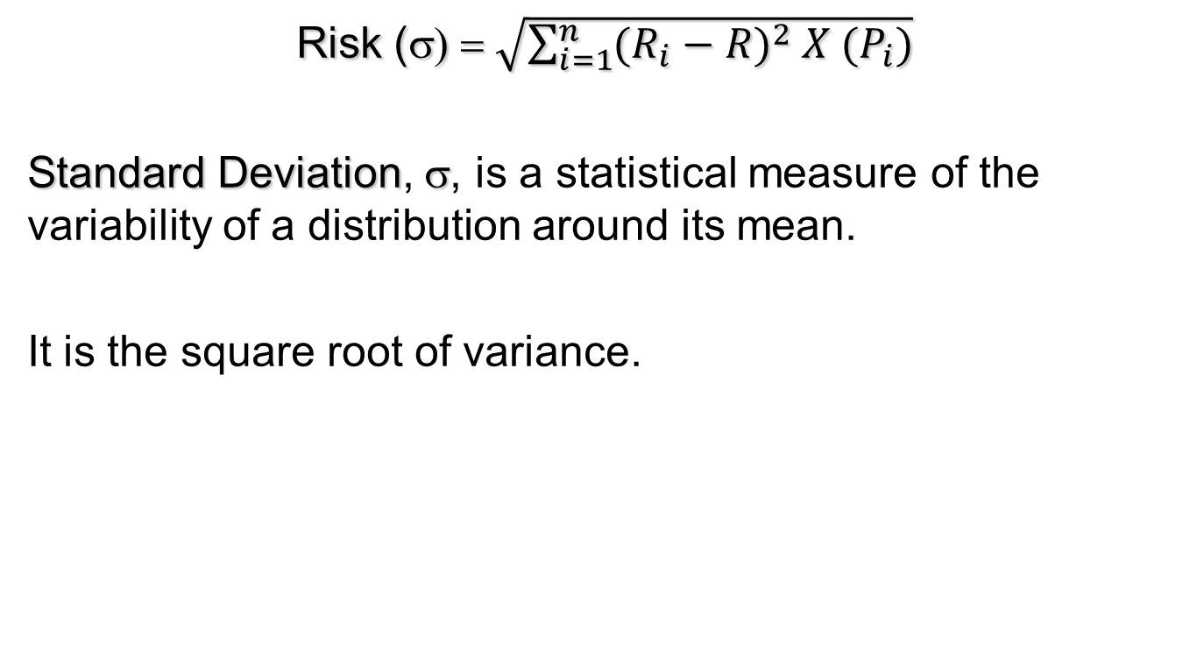
Calculation of Risk (with probability given for future scenarios)
Risk (σ) = $\sqrt{\sum_{i=1}^{n}{{(R_{i}−R)}^{2} X (P_{i})}}$
Standard Deviation, σ, is a statistical measure of the variability of a distribution around its mean.
It is the square root of variance.

Slide 12
Risk and Return Relationship
Risk-Return Trade Off says that higher the risk, higher is the return….though it is not guaranteed.
Securities are risky because their returns are variable.
The most commonly used measure of risk or variability in finance is standard deviation.
The risk of a security can be split into two parts: unique risk and market risk
Unique risk stems from firm-specific (unsystematic), whereas market risk emanates from economy-wide factors (systematic).

Slide 13
Risk- Return Trade Off
Low Risk = Low Return
Return
High Risk = High Return
Risk

Slide 14
Risk and Return Relationship
Required rate of return = Risk-free rate of return + Risk premium
Risk-free rate of return (Rf) refers to the return available on a security with no risk of default (Govt bonds).
A risk premium is a potential “reward” that an investor expects to receive when making a risky investment (computed as security return minus risk free return).
Real return + Inflation = Nominal returns
Or (1+ real return)*(1+inflation rate)= (1+Nominal return)

Slide 15
Risk and return of a portfolio
Combination of different investment in one basket
Proportion is decided based on the risk-return relationship and the risk attitude
Risk management through diversification of portfolio

Slide 16
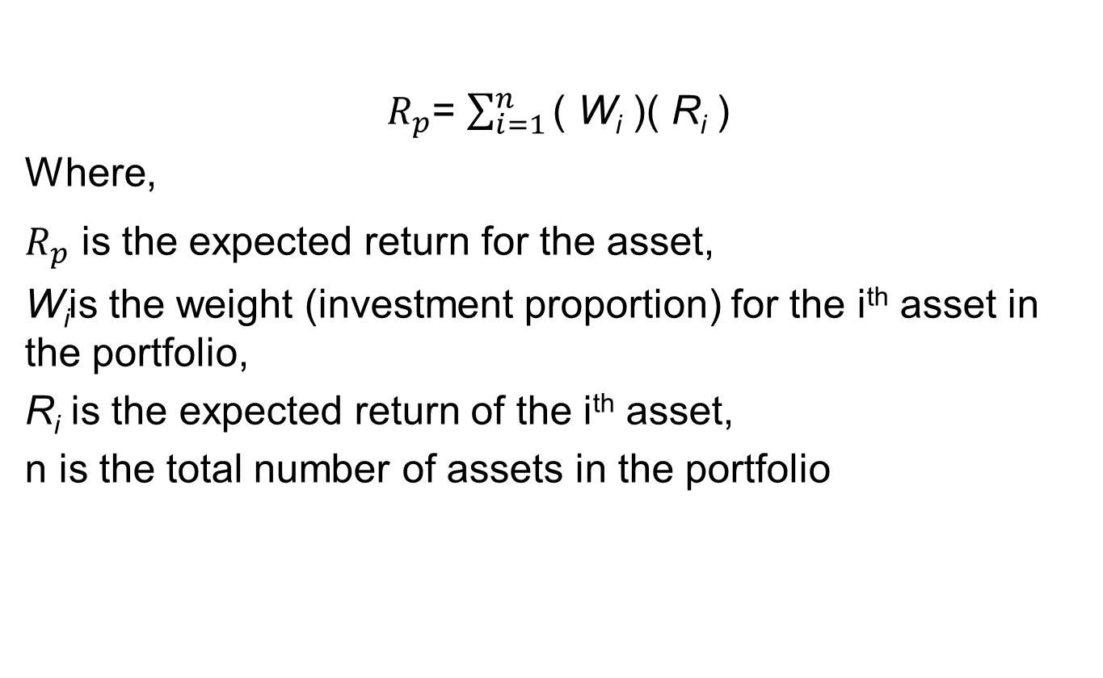
Determining Portfolio Return (Two Securities)
$R_{p}$= $\sum_{i=1}^{n}{\text{( }\text{W}\text{i}\text{ )( }\text{R}\text{i} \text{)}}$
Where,
$R_{p}$ is the expected return for the asset,
W_{i}is the weight (investment proportion) for the i^{th} asset in the portfolio,
R_{i} is the expected return of the i^{th} asset,
n is the total number of assets in the portfolio

Slide 17
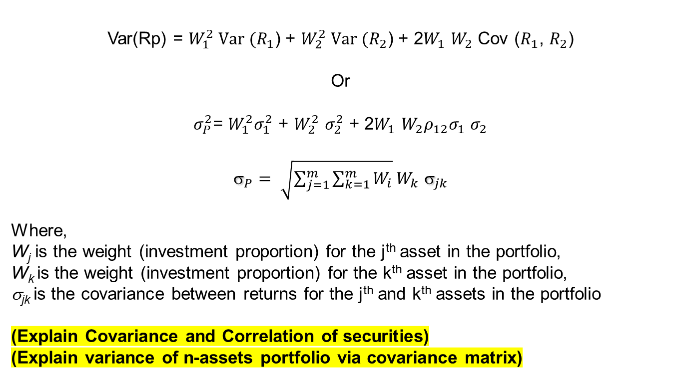
Determining Portfolio Risk (Two Securities)
Var(Rp) = $W_{1}^{2} Var (R_{1}$) + $W_{2}^{2} Var (R_{2}$) + 2$W_{1}$ $W_{2}$ Cov ($R_{1}$, $R_{2}$)
Or
$σ_{P}^{2}$= $W_{1}^{2}σ_{1}^{2}$ + $W_{2}^{2}$ $σ_{2}^{2}$ + 2$W_{1}$ $W_{2}ρ_{12}σ_{1}$ $σ_{2}$
${\text{s}}_{P}= \sqrt{\sum_{j=1}^{m}{\sum_{k=1}^{m}{W_{i}}}}W_{k}$ ${\text{s}}_{jk}$
Where,
W_{j} is the weight (investment proportion) for the j^{th} asset in the portfolio,
W_{k} is the weight (investment proportion) for the k^{th} asset in the portfolio,
σ_{jk} is the covariance between returns for the j^{th} and k^{th} assets in the portfolio
(Explain Covariance and Correlation of securities)
(Explain variance of n-assets portfolio via covariance matrix)

Slide 18
Illustration: Portfolio Expected Return and Risk
State of the Economy | Probability | Return on Stock A | Return on Stock B | Return on Portfolio
1 | 0.2 | 15% | -5% | 5%
2 | 0.2 | -5% | 15% | 5%
3 | 0.2 | 5% | 25% | 15%
4 | 0.2 | 35% | 5% | 20%
5 | 0.2 | 25% | 35% | 30%
What is the expected return and risk if you invest only in stock A?
What is the expected return and risk if you invest only in stock B?
What is the expected return and risk if you invest in a portfolio consisting of stock A and B in equal proportion?

Slide 19
THANK YOU!!!

